Slide 1
Structured Query Language (SQL)

Slide 2
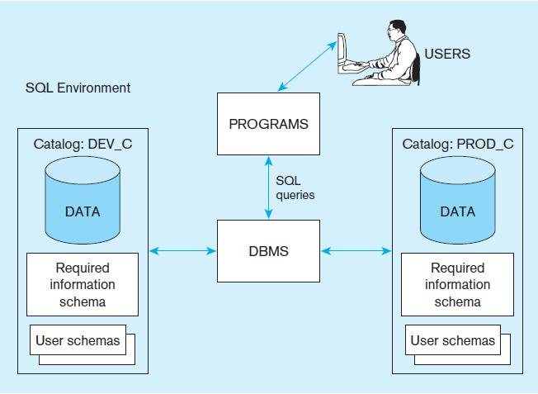
A simplified schematic of a typical SQL environment
2

Slide 3
Basic Query Structure
A typical SQL query has the form: select A₁, A₂, ..., A_{n} from r₁, r₂, ..., r_{m} where P
A_{i} represents an attribute
R_{i} represents a relation
P is a predicate.
The result of an SQL query is a relation.
Notes:
2

Slide 4
The select Clause
The select clause lists the attributes desired in the result of a query
corresponds to the projection operation of the relational algebra
Example: find the names of all instructors: select name from instructor
NOTE: SQL names are case insensitive (i.e., you may use upper- or lower-case letters.)
E.g., Name ≡ NAME ≡ name
Some people use upper case wherever we use bold font.
Notes:
3

Slide 5
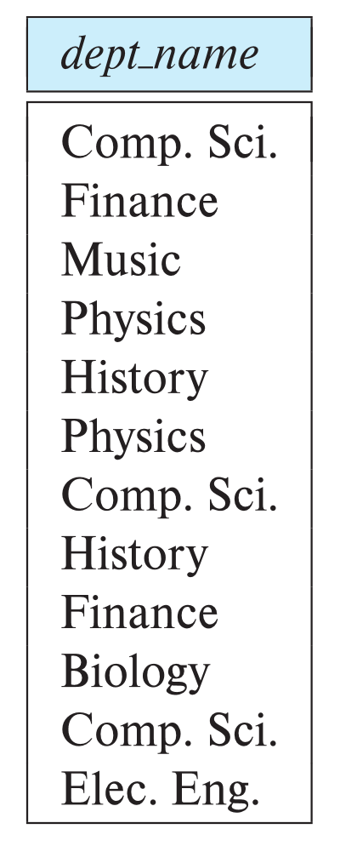
The select Clause (Cont.)
SQL allows duplicates in relations as well as in query results.
To force the elimination of duplicates, insert the keyword distinct after select.
Find the department names of all instructors, and remove duplicates
select distinct dept_name from instructor
The keyword all specifies that duplicates should not be removed.
select all dept_name from instructor
Notes:
4

Slide 6
The select Clause (Cont.)
An asterisk in the select clause denotes “all attributes”
select * from instructor
An attribute can be a literal with no from clause
select '437'
Results is a table with one column and a single row with value “437”
Can give the column a name using:
select '437' as TEST
An attribute can be a literal with from clause
select 'A' from instructor
Result is a table with one column and N rows (number of tuples in the instructors table), each row with value “A”
Notes:
5

Slide 7
The select Clause (Cont.)
The select clause can contain arithmetic expressions involving the operation, +, –, ∗, and /, and operating on constants or attributes of tuples.
The query:
select ID, name, salary/12 from instructor
would return a relation that is the same as the instructor relation, except that the value of the attribute salary is divided by 12.
Can rename “salary/12” using the as clause:
select ID, name, salary/12 as monthly_salary
Notes:
5

Slide 8
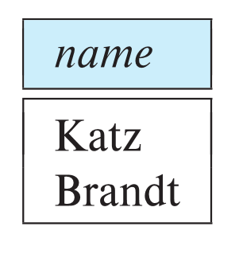
The where Clause
The where clause specifies conditions that the result must satisfy
Corresponds to the selection predicate of the relational algebra.
To find all instructors in Comp. Sci. dept
select name from instructor where dept_name = 'Comp. Sci.'
SQL allows the use of the logical connectives and, or, and not
The operands of the logical connectives can be expressions involving the comparison operators <, <=, >, >=, =, and <> (not null).
Comparisons can be applied to results of arithmetic expressions
To find all instructors in Comp. Sci. dept with salary > 70000
select name from instructor where dept_name = 'Comp. Sci.' and salary > 70000
Notes:
6

Slide 9
The from Clause
The from clause lists the relations involved in the query
Corresponds to the Cartesian product operation of the relational algebra.
Find the Cartesian product instructor X teaches
select ∗ from instructor, teaches
generates every possible instructor – teaches pair, with all attributes from both relations.
For common attributes (e.g., ID), the attributes in the resulting table are renamed using the relation name (e.g., instructor.ID)
Cartesian product not very useful directly, but useful combined with where-clause condition (selection operation in relational algebra).
Notes:
8

Slide 10
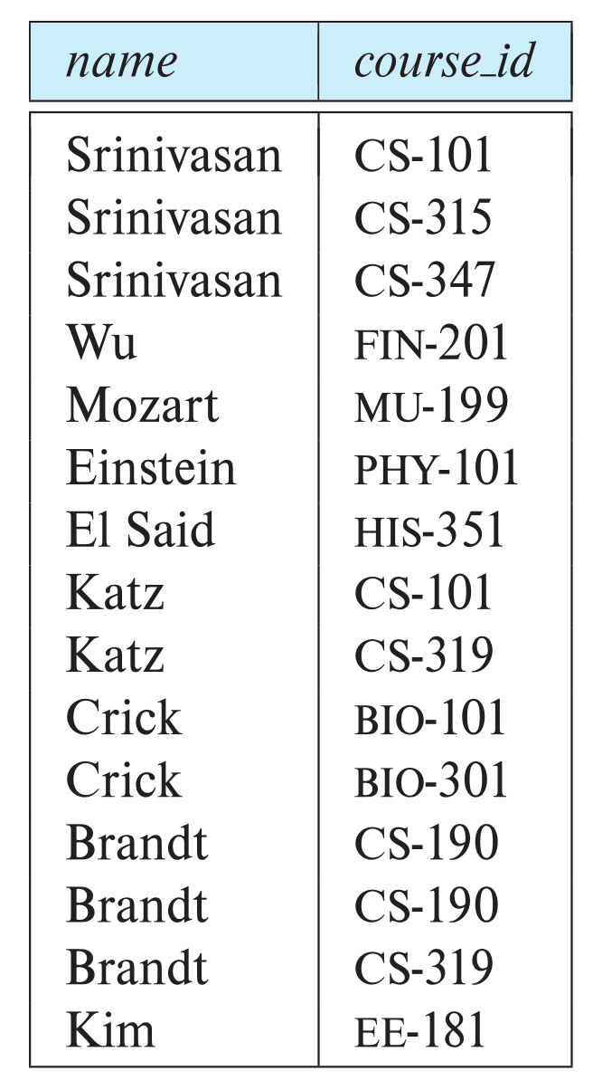
Examples
Find the names of all instructors who have taught some course and the course_id
select name, course_id from instructor , teaches where instructor.ID = teaches.ID
Find the names of all instructors in the Art department who have taught some course and the course_id
select name, course_id from instructor , teaches where instructor.ID = teaches.ID and instructor. dept_name = 'Art'
Notes:
9

Slide 11
The Rename Operation
The SQL allows renaming relations and attributes using the as clause:
old-name as new-name
Find the names of all instructors who have a higher salary than some instructor in 'Comp. Sci'.
select distinct T.name from instructor as T, instructor as S where T.salary > S.salary and S.dept_name = 'Comp. Sci.’
Keyword as is optional and may be omitted instructor as T ≡ instructor T
Notes:
9

Slide 12
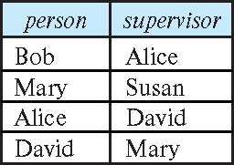
Self Join Example
Relation emp-super
Find the supervisor of “Bob”
Find the supervisor of the supervisor of “Bob”
Can you find ALL the supervisors (direct and indirect) of “Bob”?
Notes:
9

Slide 13
String Operations
SQL includes a string-matching operator for comparisons on character strings. The operator like uses patterns that are described using two special characters:
percent ( % ). The % character matches any substring.
underscore ( _ ). The _ character matches any character.
Find the names of all instructors whose name includes the substring “dar”.
select name from instructor where name like '%dar%'
Match the string “100%”
like '100 \%' escape '\'
in that above we use backslash (\) as the escape character.

Slide 14
String Operations (Cont.)
Patterns are case sensitive.
Pattern matching examples:
'Intro%' matches any string beginning with “Intro”.
'%Comp%' matches any string containing “Comp” as a substring.
'_ _ _' matches any string of exactly three characters.
'_ _ _ %' matches any string of at least three characters.
SQL supports a variety of string operations such as
concatenation (using “||”)
converting from upper to lower case (and vice versa)
finding string length, extracting substrings, etc.

Slide 15
Ordering the Display of Tuples
List in alphabetic order the names of all instructors
select distinct name from instructor order by name
We may specify desc for descending order or asc for ascending order, for each attribute; ascending order is the default.
Example: order by name desc
Can sort on multiple attributes
Example: order by dept_name, name

Slide 16
Where Clause Predicates
SQL includes a between comparison operator
Example: Find the names of all instructors with salary between $90,000 and $100,000 (that is, ≥ $90,000 and ≤ $100,000)
select name from instructor where salary between 90000 and 100000
Tuple comparison
select name, course_id from instructor, teaches where (instructor.ID, dept_name) = (teaches.ID, 'Biology');
Notes:
7

Slide 17
Set Operations
Find courses that ran in Fall 2017 or in Spring 2018
(select course_id from section where sem = 'Fall' and year = 2017) union (select course_id from section where sem = 'Spring' and year = 2018)
Find courses that ran in Fall 2017 and in Spring 2018
(select course_id from section where sem = 'Fall' and year = 2017) intersect (select course_id from section where sem = 'Spring' and year = 2018)
Find courses that ran in Fall 2017 but not in Spring 2018
(select course_id from section where sem = 'Fall' and year = 2017) except (select course_id from section where sem = 'Spring' and year = 2018)

Slide 18
Set Operations (Cont.)
Set operations union, intersect, and except
Each of the above operations automatically eliminates duplicates
To retain all duplicates use the
union all,
intersect all
except all.

Slide 19
Null Values
It is possible for tuples to have a null value, denoted by null, for some of their attributes
null signifies an unknown value or that a value does not exist.
The result of any arithmetic expression involving null is null
Example: 5 + null returns null
The predicate is null can be used to check for null values.
Example: Find all instructors whose salary is null.
select name from instructor where salary is null
The predicate is not null succeeds if the value on which it is applied is not null.

Slide 20
Null Values (Cont.)
SQL treats as unknown the result of any comparison involving a null value (other than predicates is null and is not null).
Example: 5 < null or null <> null or null = null
The predicate in a where clause can involve Boolean operations (and, or, not); thus the definitions of the Boolean operations need to be extended to deal with the value unknown.
and : (true and unknown) = unknown, (false and unknown) = false, (unknown and unknown) = unknown
or: (unknown or true) = true, (unknown or false) = unknown (unknown or unknown) = unknown
Result of where clause predicate is treated as false if it evaluates to unknown

Slide 21
Aggregate Functions
These functions operate on the multiset of values of a column of a relation, and return a value
avg: average value min: minimum value max: maximum value sum: sum of values count: number of values

Slide 22
Aggregate Functions Examples
Find the average salary of instructors in the Computer Science department
select avg (salary) from instructor where dept_name= 'Comp. Sci.';
Find the total number of instructors who teach a course in the Spring 2018 semester
select count (distinct ID) from teaches where semester = 'Spring' and year = 2018;
Find the number of tuples in the course relation
select count (*) from course;

Slide 23
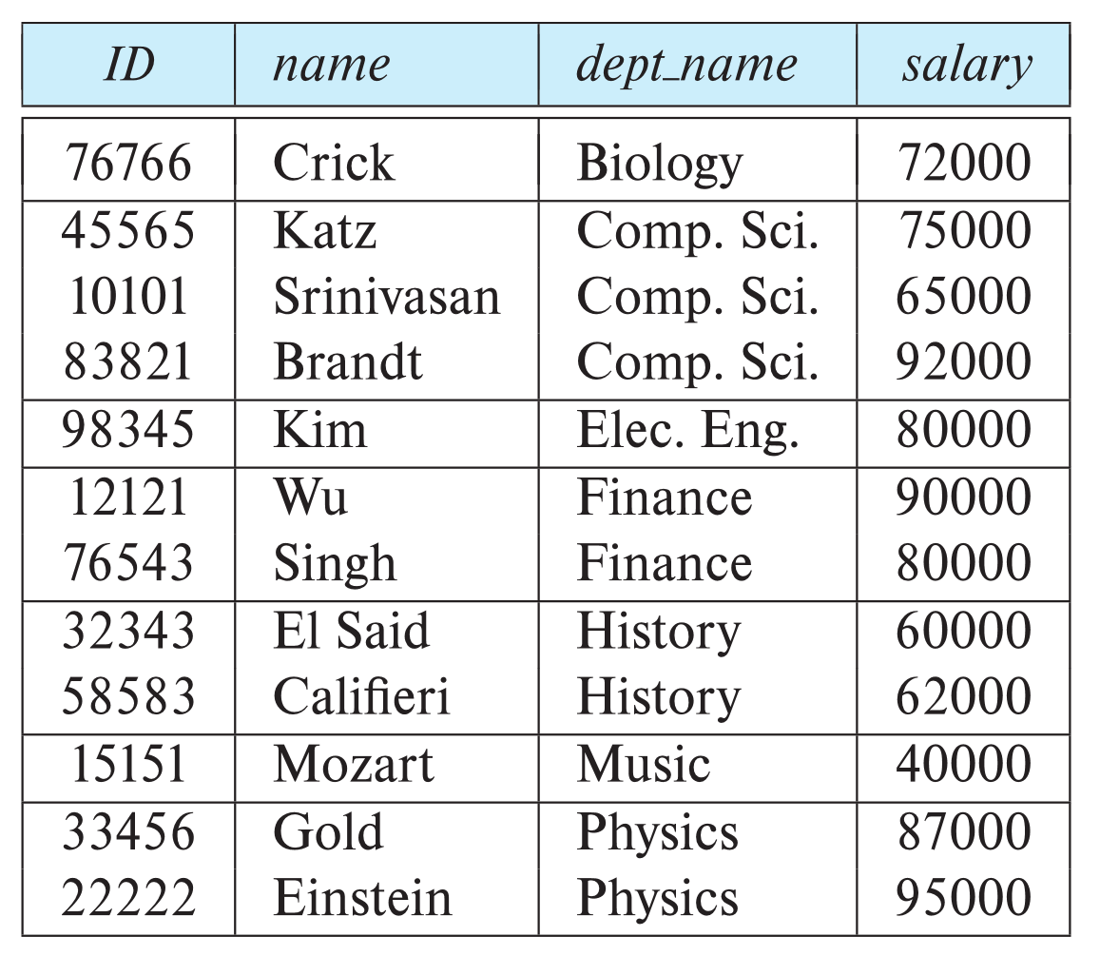
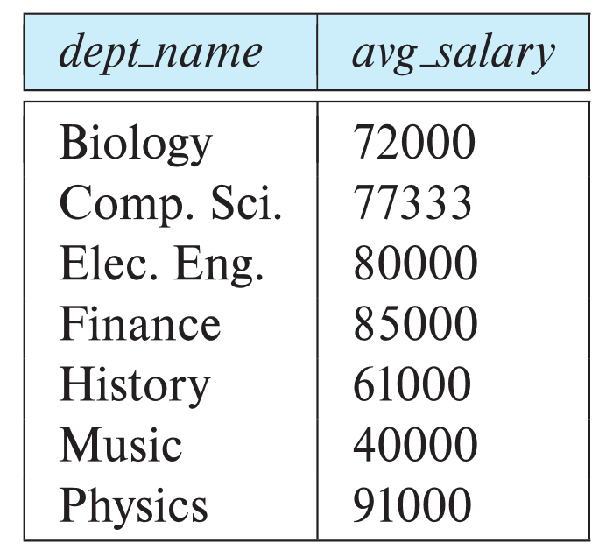
Aggregate Functions – Group By
Find the average salary of instructors in each department
select dept_name, avg (salary) as avg_salary from instructor group by dept_name;

Slide 24
Aggregation (Cont.)
Attributes in select clause outside of aggregate functions must appear in group by list
/* erroneous query */ select dept_name, ID, avg (salary) from instructor group by dept_name;
What’s wrong?

Slide 25
Aggregate Functions – Having Clause
Find the names and average salaries of all departments whose average salary is greater than 42000
Note: predicates in the having clause are applied after the formation of groups whereas predicates in the where clause are applied before forming groups
select dept_name, avg (salary) as avg_salary
from instructor
group by dept_name
having avg (salary) > 42000;

Slide 26
SQL Examples Now, we will run diverse SQL query types on different databases from https://www.w3schools.com/sql/default.asp Open your exercise books and write. The example queries are not in the slides!

